Slide 1
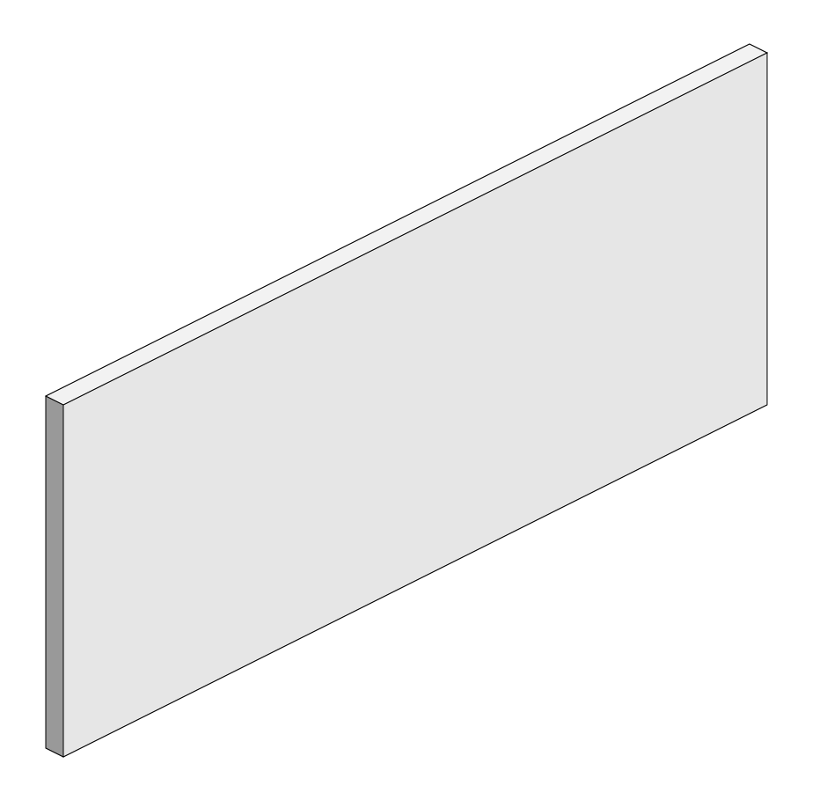
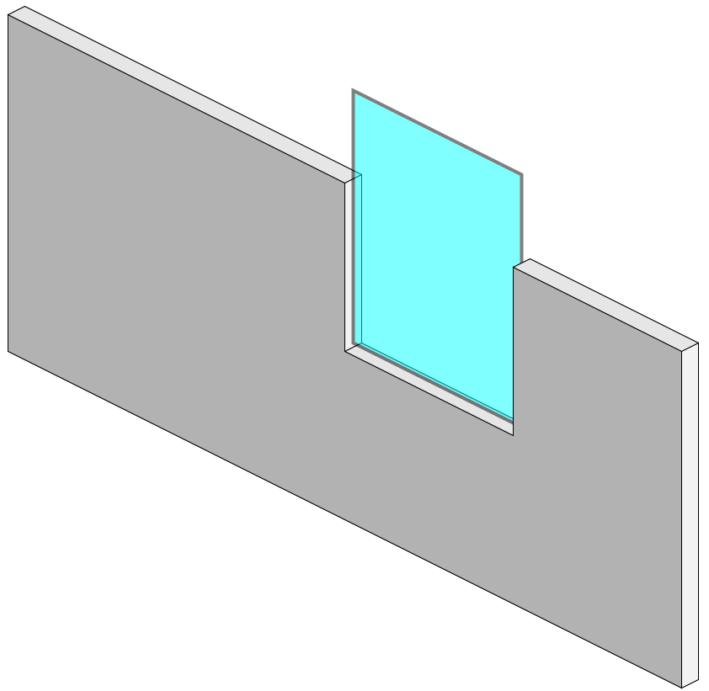
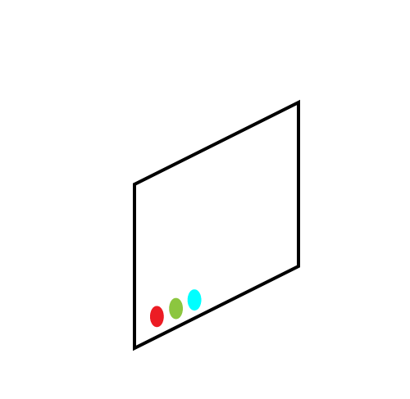


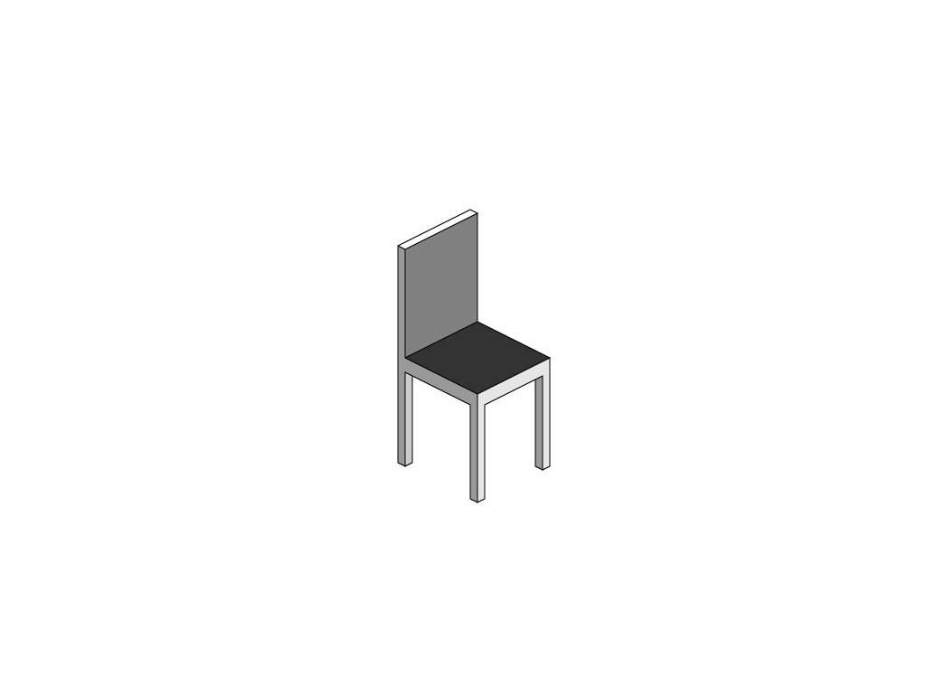


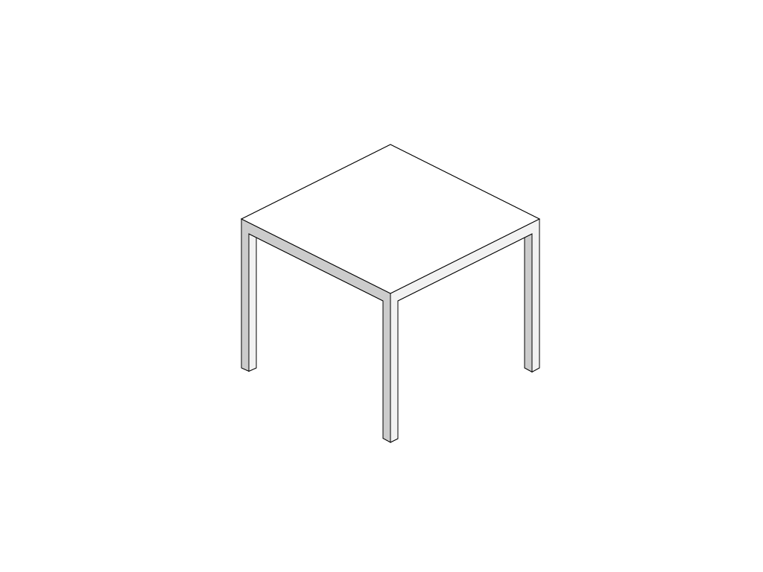
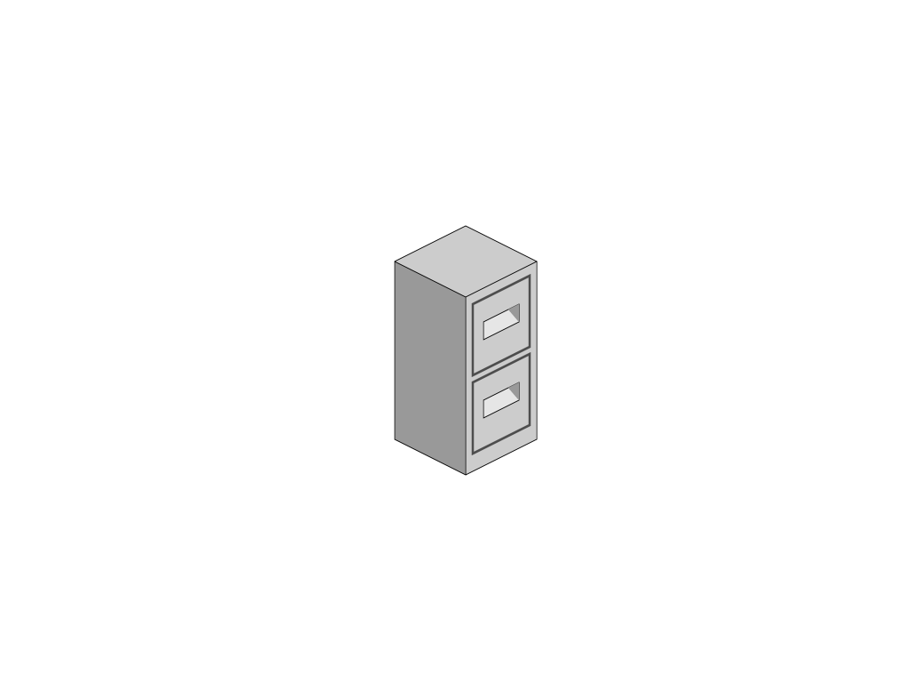

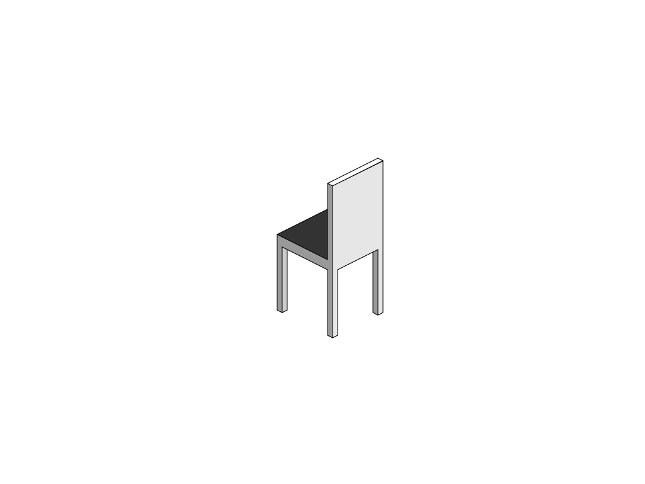

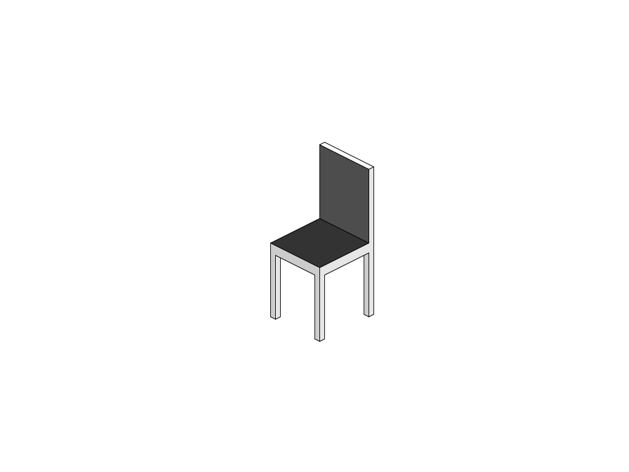

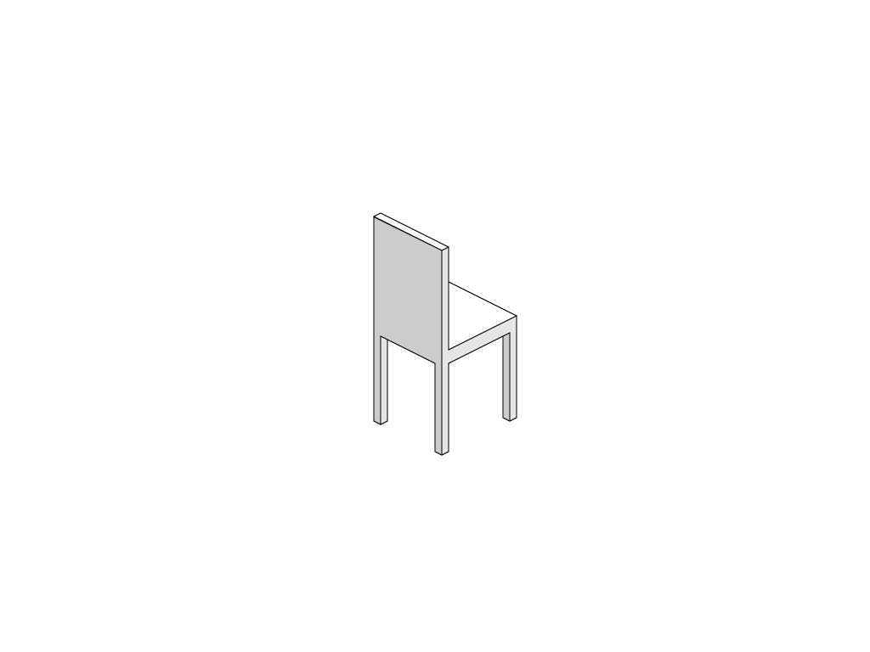

Office Clipart
Just copy and paste the images you need into your presentation,
place them in layers and scale them to suit your needs

Slide 2
People

Slide 3
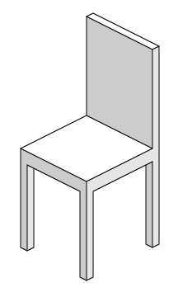
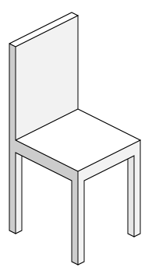

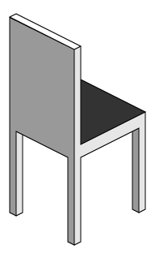
Chairs

Slide 4
Office Furniture

Slide 5
Chairs & Table

Slide 6



Office Furniture

Slide 7

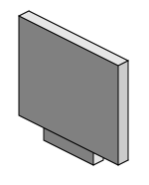
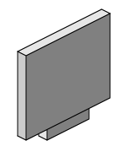



Computer Screen

Slide 8
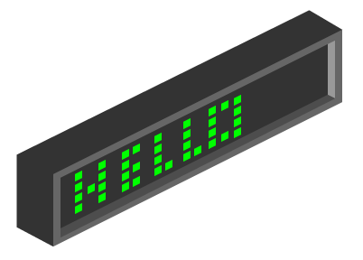
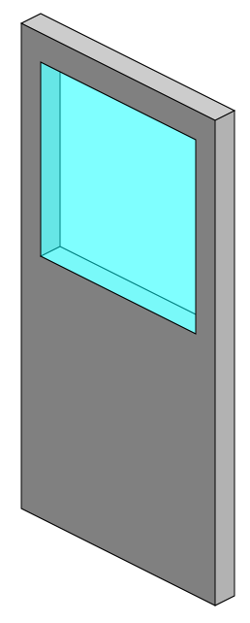
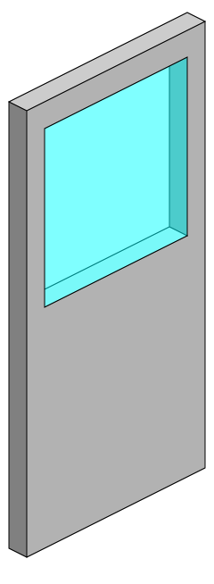
Office Furniture

Slide 9
Office Walls and Door

Slide 10
Office Walls

Slide 11
Office Walls with Window

Slide 12
Office Floor

Slide 13

EXAMPLE LAYOUT

Slide 14
Small Office Items

Slide 15
Use of templates
You are free to use these templates for your personal and business presentations.
We have put a lot of work into developing all these templates and retain the copyright in them. You can use them freely providing that you do not redistribute or sell them.
Do
Use these templates for your presentations
Display your presentation on a web site provided that it is not for the purpose of downloading the template.
If you like these templates, we would always appreciate a link back to our website. Many thanks.
Don’t
Resell or distribute these templates
Put these templates on a website for download. This includes uploading them onto file sharing networks like Slideshare, Myspace, Facebook, bit torrent etc
Pass off any of our created content as your own work
  You can find many more free PowerPoint templates on the Presentation Magazine website www.presentationmagazine.com

