Slide 1
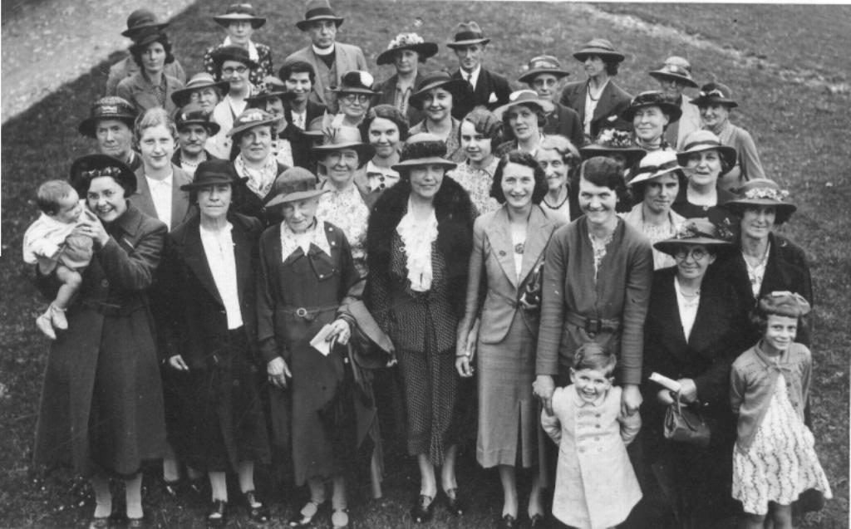
The Ken Burns effect
PowerPoint Tutorial

Slide 2
The Ken Burns effect
The Ken Burns Effect, made famous by American documentary maker Ken Burns, is the technique of embedding still photographs in motion pictures, displayed with slow zooming and panning effects, and fading transitions between them.
The zooming and panning across photographs gives the feeling of motion, and keeps the viewer visually entertained.

Slide 3
The basic Ken Burns effect
The basic Ken Burns effect that is included in Apple’s iMovie software package is simply a zoom feature.
This is fairly easy to replicate in PowerPoint, but the only drawback is that you have to zoom into the centre of the image.

Slide 4
Basic Ken Burns effect using
Grow/ Shrink Size: 150% Speed: Slow

Slide 5
Same effect with a frame over the top

Slide 6
Custom motion path
To zoom in on the old lady we first need to use
a custom motion path to bring her to the centre of the screen.
(Note because we have not zoomed in the edge of the
photo will show up in the frame.)

Slide 7
Custom motion path combined with Grow/ Shrink
If we combine the Grow/ Shrink and the Custom Motion path we get a
good approximation of the Ken Burns effect

Slide 8
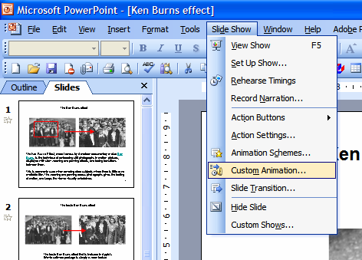
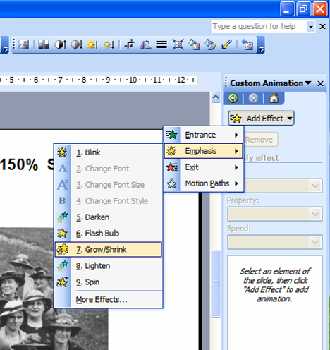
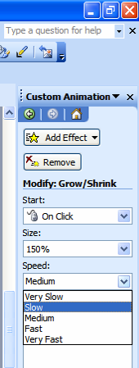
How we did it
Basic Ken Burns effect using
Grow/ Shrink Size:150% Speed :Slow
1
2
3
Select
Slide Show > Custom Animation
Select
Grow/ Shrink
Make timing to
Slow or Very Slow

Slide 9
How we did it
Adding a frame
No Line
No Line
No Line
No Fill
No line

Slide 10
How we did it
Adding a frame
No Line
No Line
No Line
No Fill
No line

Slide 11
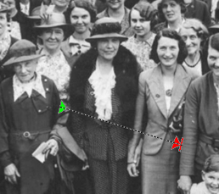
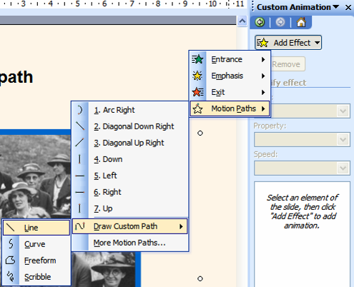
How we did it
Creating a custom motion path
1
3
Select
Slide Show > Custom Animation
2
Move the green and red arrows and keep testing until you get the centre of the picture in the right place (this can be very fiddly to get right)
Select
Add Effect > Motion Paths > Draw Custom Path > Line

Slide 12
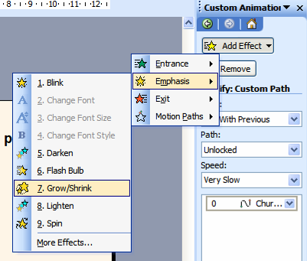
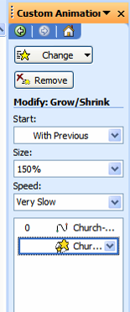
How we did it
Combining motion path with Grow/ Shrink
1
2
In Custom Animation add in the
Grow/ Shrink as before
To make both animations start at the same time, select
Start > With Previous
You may need to play around with the settings to get it working the way you want

