Slide 1
Simple PowerPoint Menus
Section 1
Section 2
Section 3
Tutorial

Slide 2
Section 1 Landing Page
Section 1 Heading
Return to
Menu

Slide 3
Section 1 Content Page
The content of the section would go in here
Return to
Menu

Slide 4
Section 2 Landing Page
Section 2 Heading
Return to
Menu

Slide 5
Section 2 Content Page
The content of the section would go in here
Return to
Menu

Slide 6
Section 3 Landing Page
Section 3 Heading
Return to
Menu

Slide 7
Section 3 Content Page
The content of the section would go in here
Return to
Menu

Slide 8
Tutorial
How to make a
Simple PowerPoint Menu
Return to
Menu

Slide 9
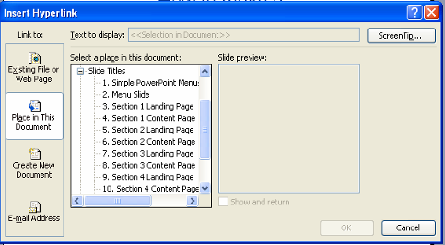
How to make a
Simple PowerPoint Menu
1. Add in a text box as your menu button
2. From the menu select Insert > Hyperlink
3. Select Place in this Document
4. Select the page that you want to link in to
5. Repeat for all the buttons in the document
3
4
Return to
Menu

Slide 10

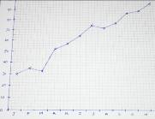
Most PowerPoint objects can be hyperlinked
Text can be hyperlinked
Text boxes
Circles
Objects with
shadow
Images
Images in
Auto shapes
Return to
Menu

