Slide 1
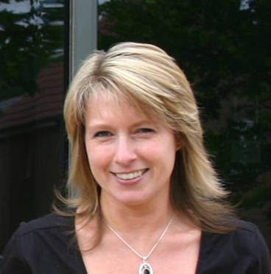
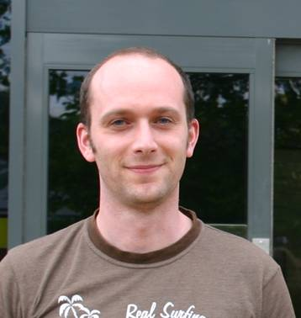
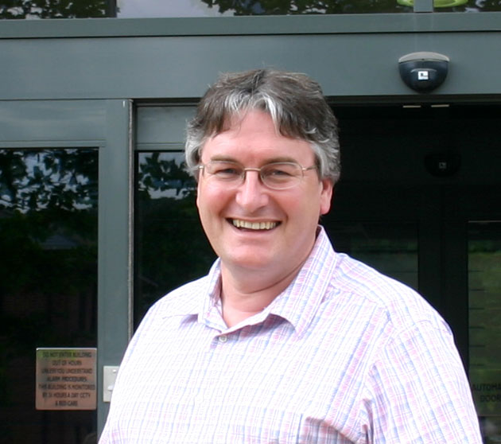
PowerPoint Photo frames
Jon
Jo
Easy to use templates

Slide 2
Rectangle (vector)
Jo
Jon
You can change the colours of this frame in PowerPoint.
Just pop the picture behind the frame

Slide 3
Rounded corners (Vector)
Jo
Jon

Slide 4
Square (Vector)

Slide 5
Rectangular bevelled
Jo
Jonty

Slide 6
Rounded corners bevelled
Jo
Jon

Slide 7
Rounded corners bevel shadow
Jonty
Jon

Slide 8
For more free PowerPoint templates
Visit the Presentation Magazine website at www.presentationmagazine.com

