Slide 1

Wedding planning
Bride & Groom

Slide 2
Contents
Introduction
Table of events
Planning
Invitations
Guest list
Table layout
Decoration details
Image
image
image

Slide 3
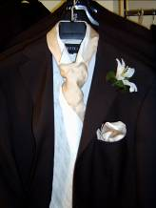
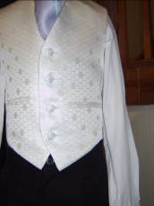
Speech quotes
When you meet someone who can cook and do housework - don't hesitate a minute - marry him.
Wedlock or deadlock? That is the question!
Marriage: A community consisting of a master, a mistress, and two slaves - making in all, two.

Slide 4
Event timetable
Objective | Contact | Completion date
Organise dress fitting |  | 12/07/06
Confirm venue and guests |  | 14/07/06

Slide 5
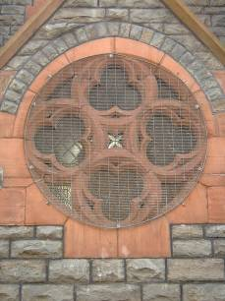
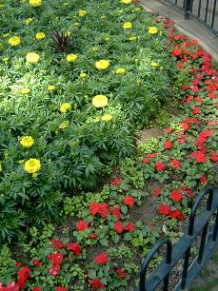
photos
Footnote the above
images
Footnote the
images above

Slide 6
Use of templates
You are free to use these templates for your personal and business presentations.
We have put a lot of work into developing all these templates and retain the copyright in them. They are not Open Source templates. You can use them freely providing that you do not redistribute or sell them.
Do
Use these templates for your presentations
Display your presentation on a web site provided that it is not for the purpose of downloading the template.
If you like these templates, we would always appreciate a link back to our website. Many thanks.
Don’t
Resell or distribute these templates
Put these templates on a website for download. This includes uploading them onto file sharing networks like Slideshare, Myspace, Facebook, bit torrent etc
Pass off any of our created content as your own work
  You can find many more free templates on the Presentation Magazine website
  www.presentationmagazine.com

